Slide 1
Trade Wind Inversion

Slide 2
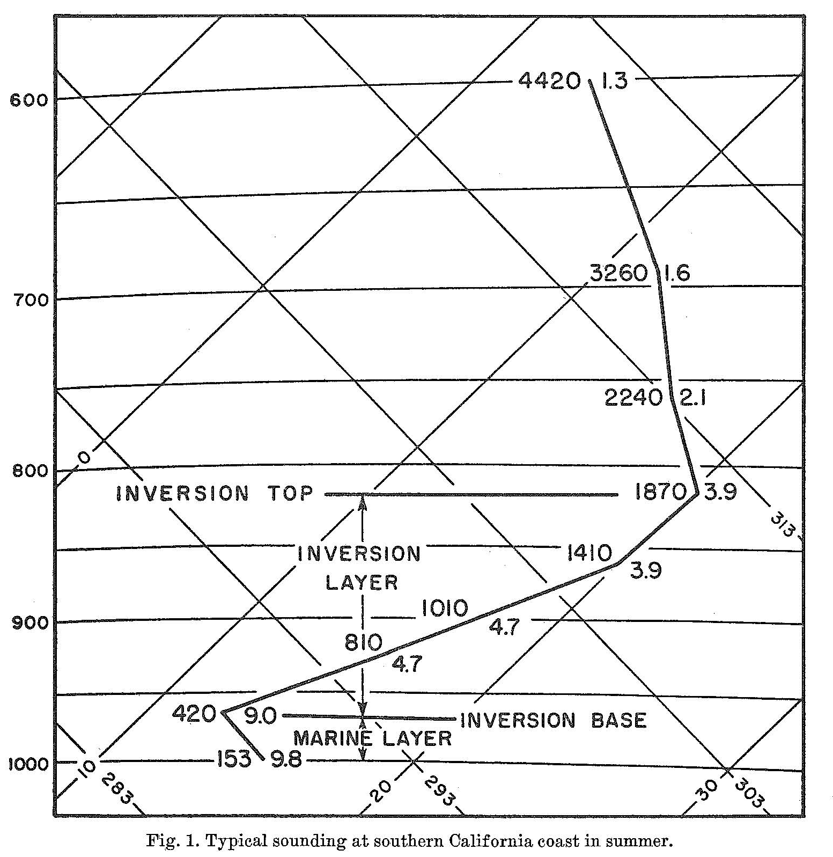
Typical Inversion Structure
Pressure
(Figure obtained from Neiburger et al. (1961), © 1961 Univ. of California Press.)

Slide 3
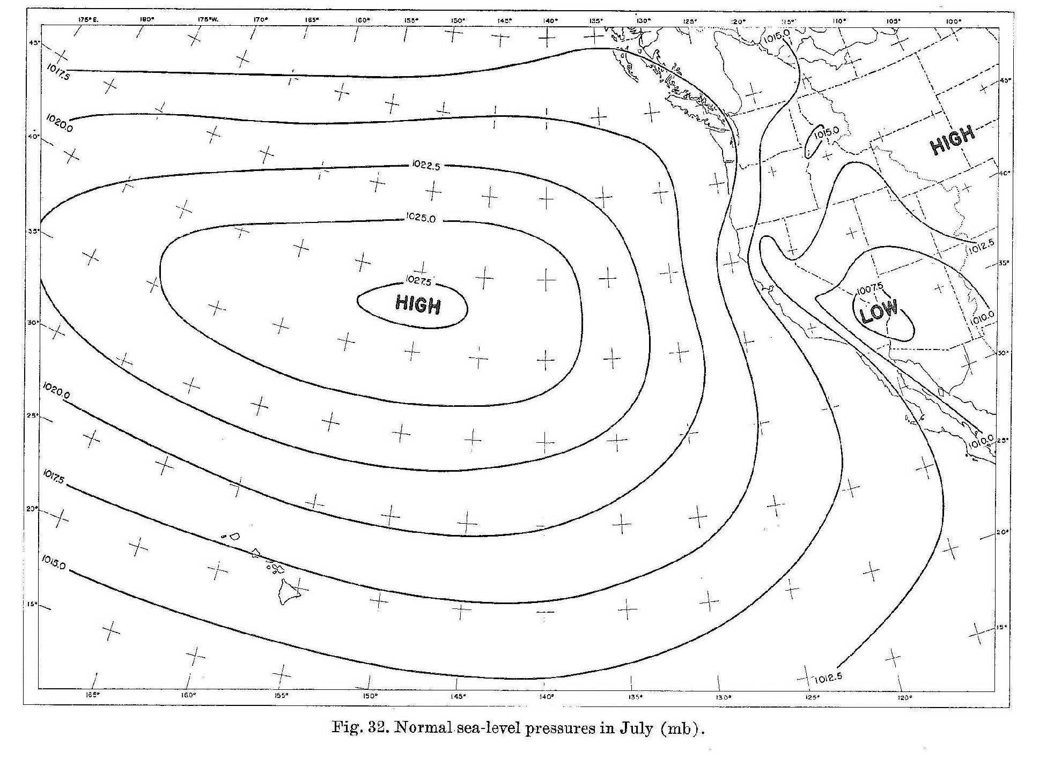
Subtropical Kinematic Structure
(Figure obtained from Neiburger et al. (1961), © 1961 Univ. of California Press.)

Slide 4
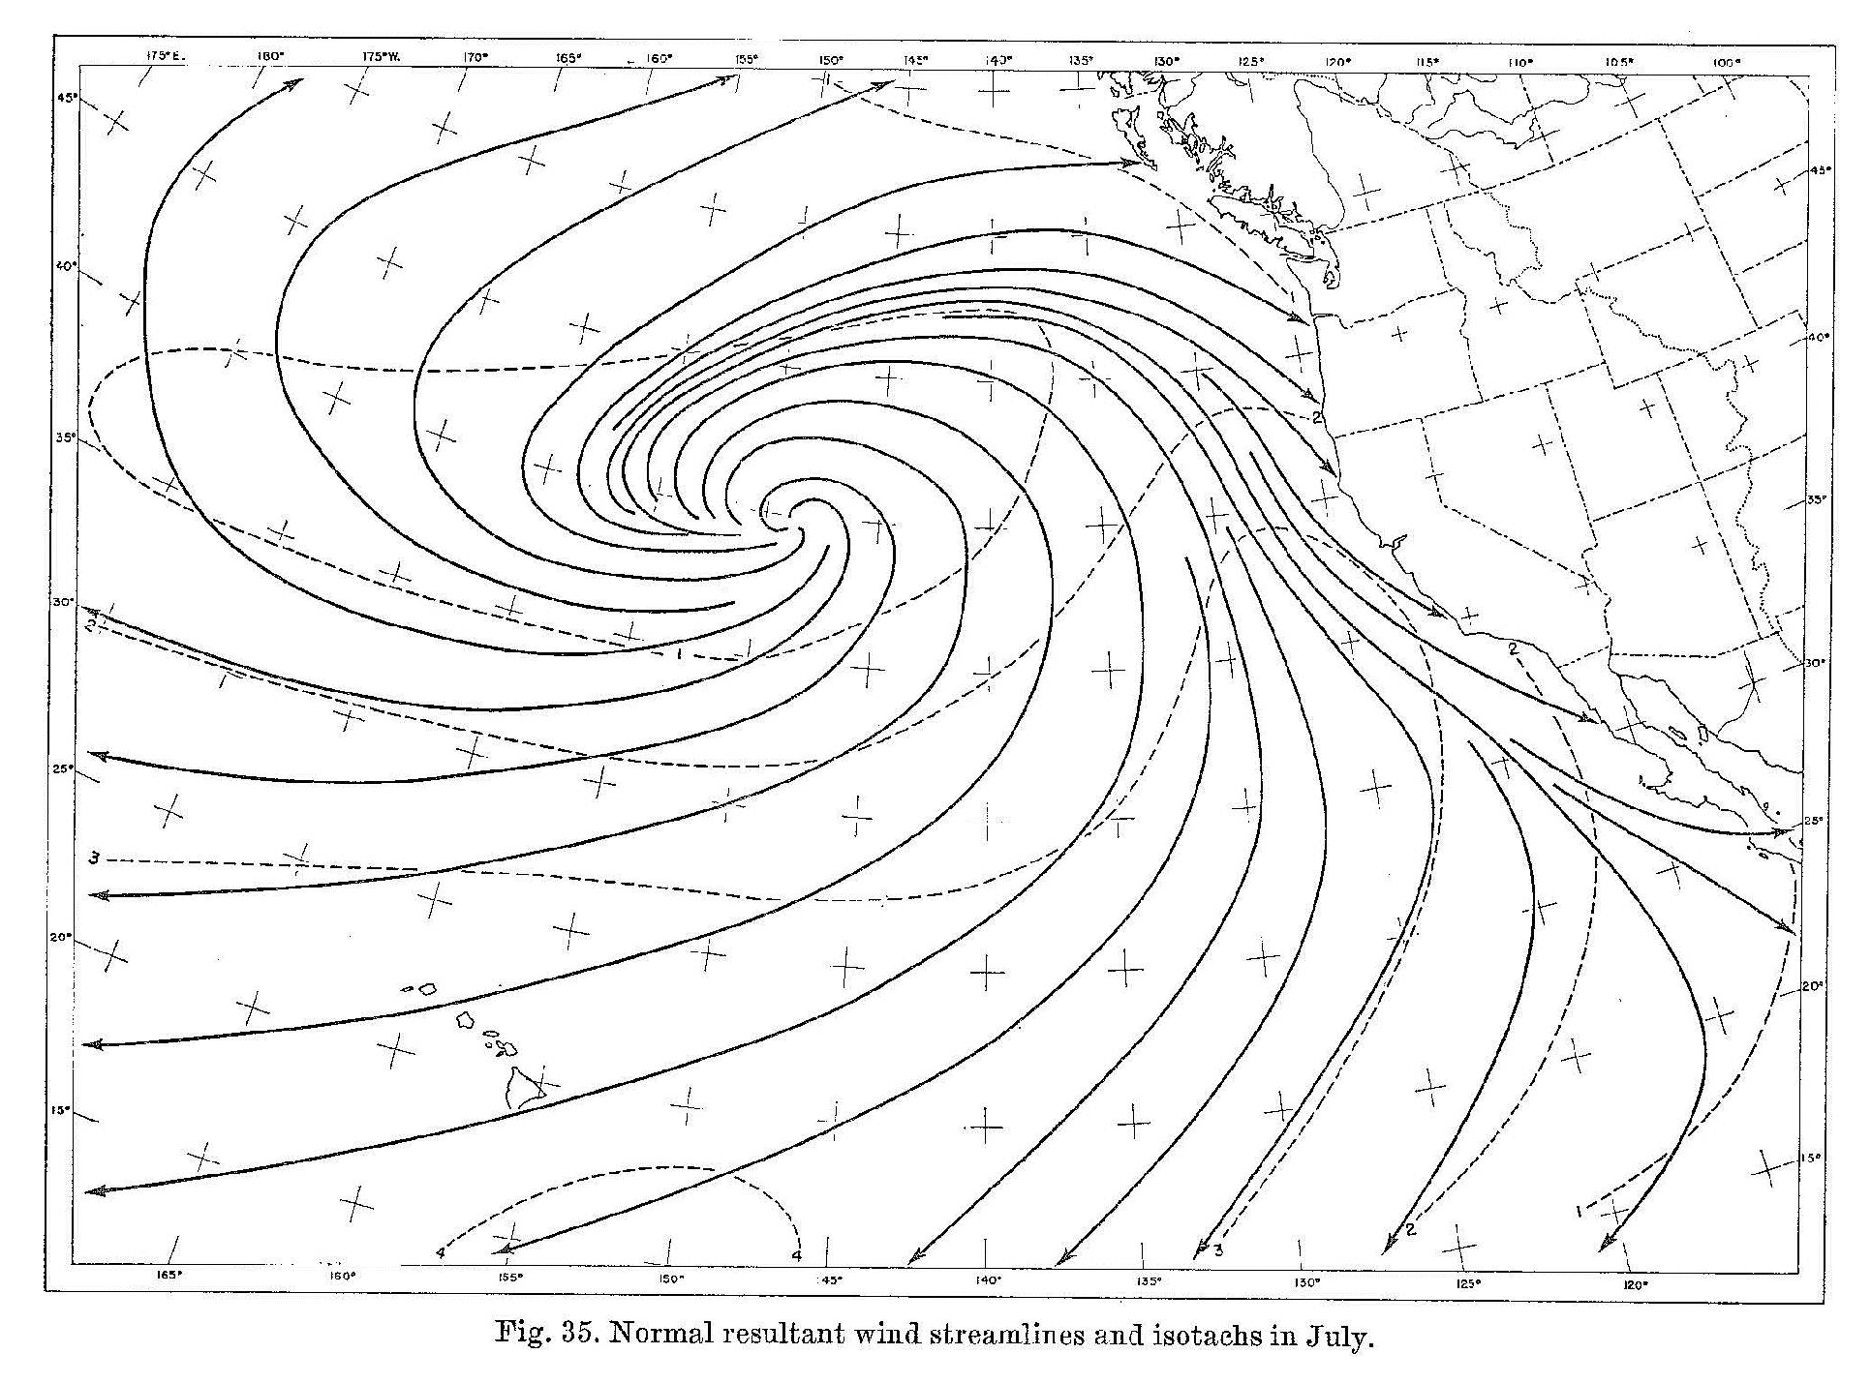
Subtropical Kinematic Structure
(Figure obtained from Neiburger et al. (1961), © 1961 Univ. of California Press.)

Slide 5
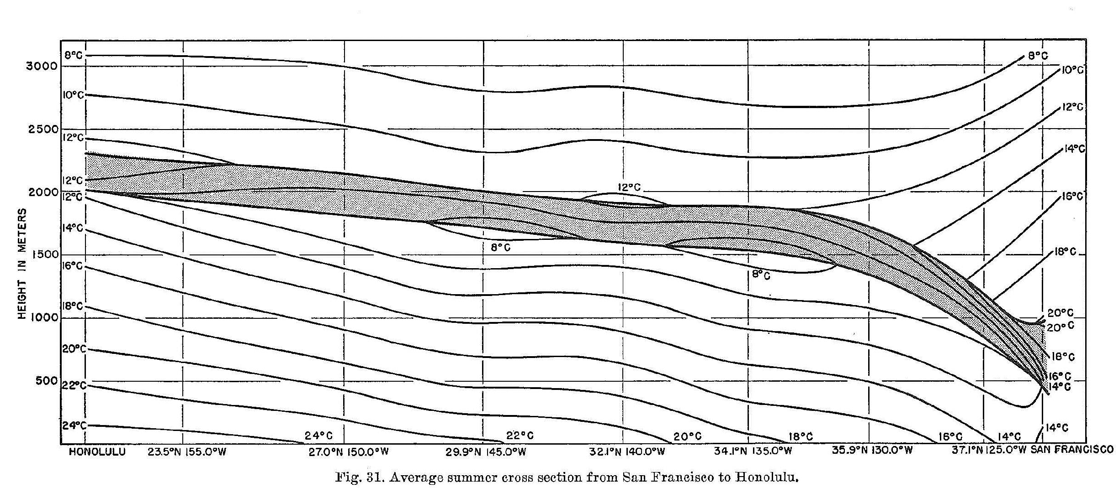
Typical Inversion Structure
(Figure obtained from Neiburger et al. (1961), © 1961 Univ. of California Press.)

Slide 6
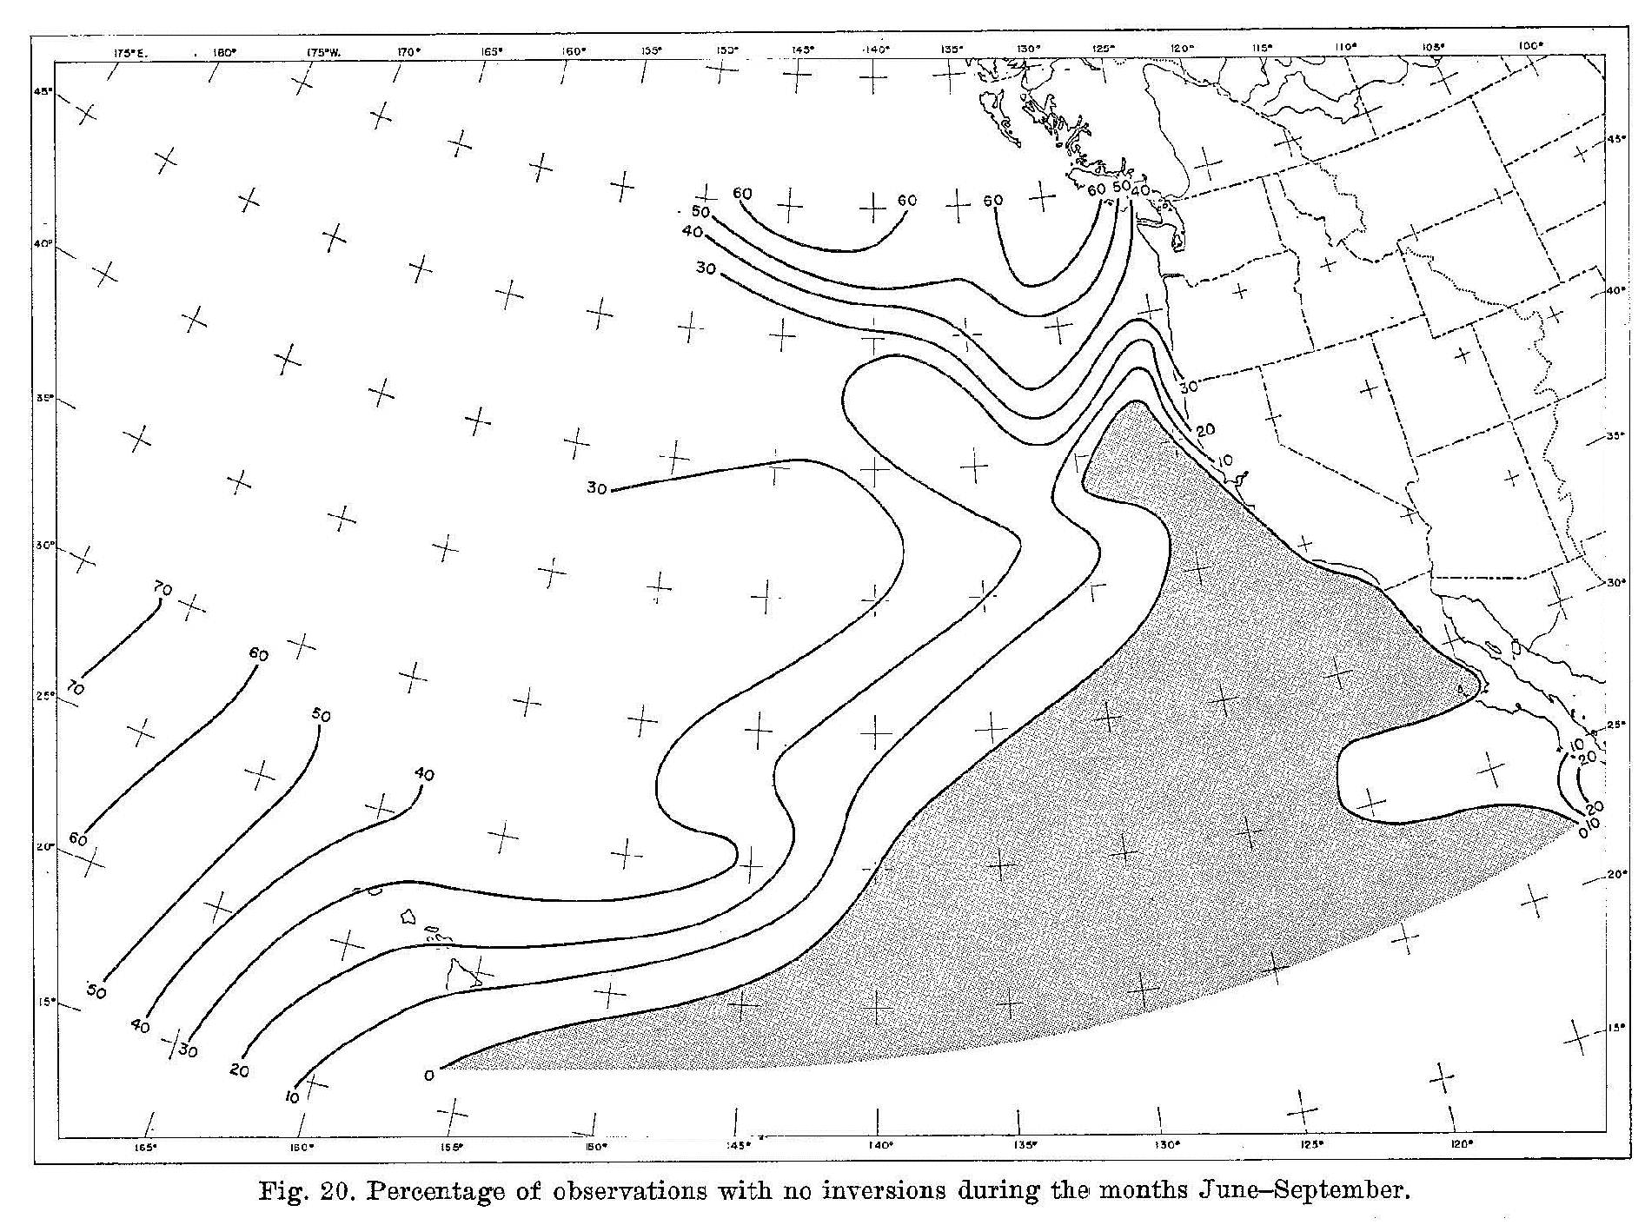
Frequency of Inversion Occurrence
(Figure obtained from Neiburger et al. (1961), © 1961 Univ. of California Press.)

Slide 7
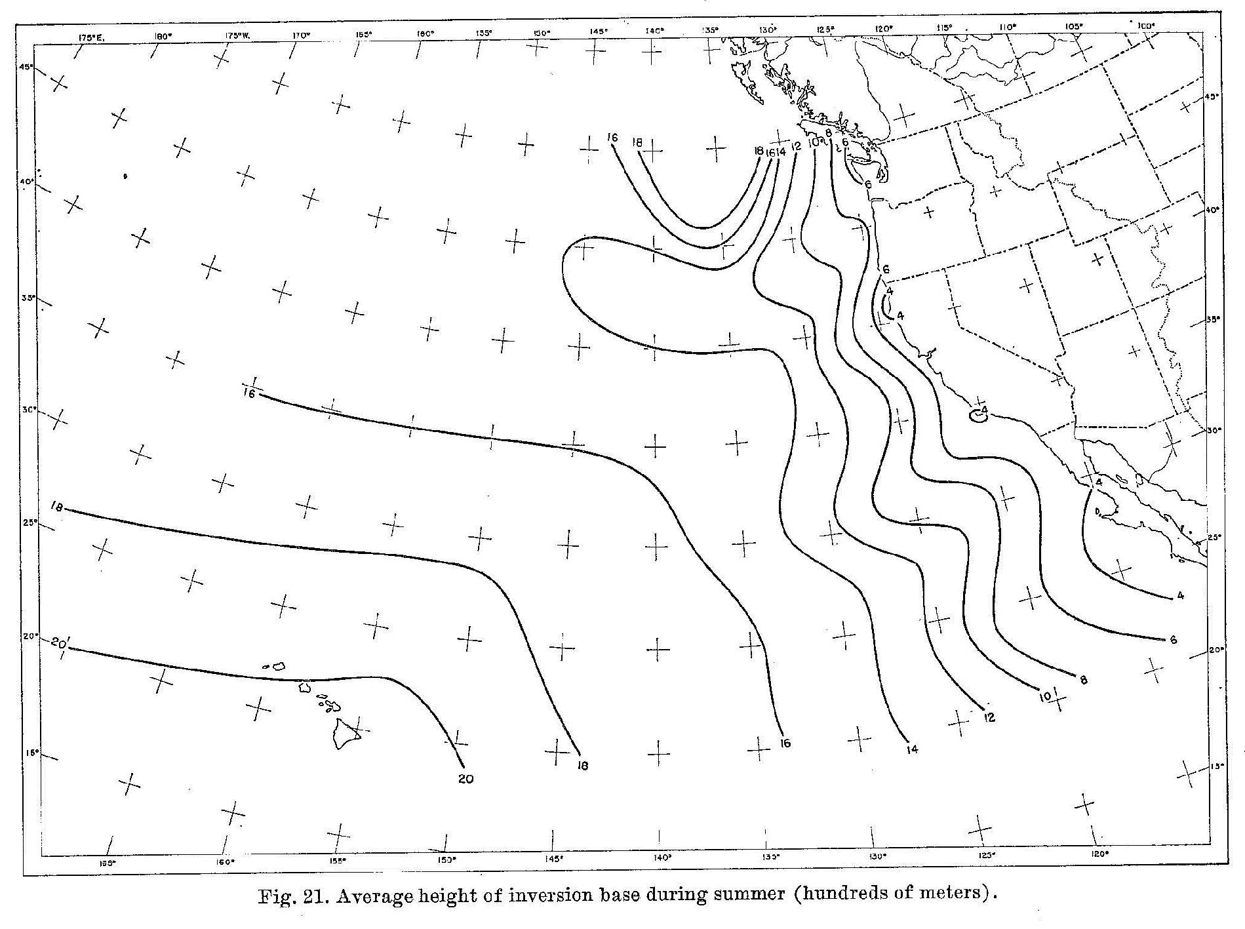
Height of Inversion Base
(Figure obtained from Neiburger et al. (1961), © 1961 Univ. of California Press.)

Slide 8
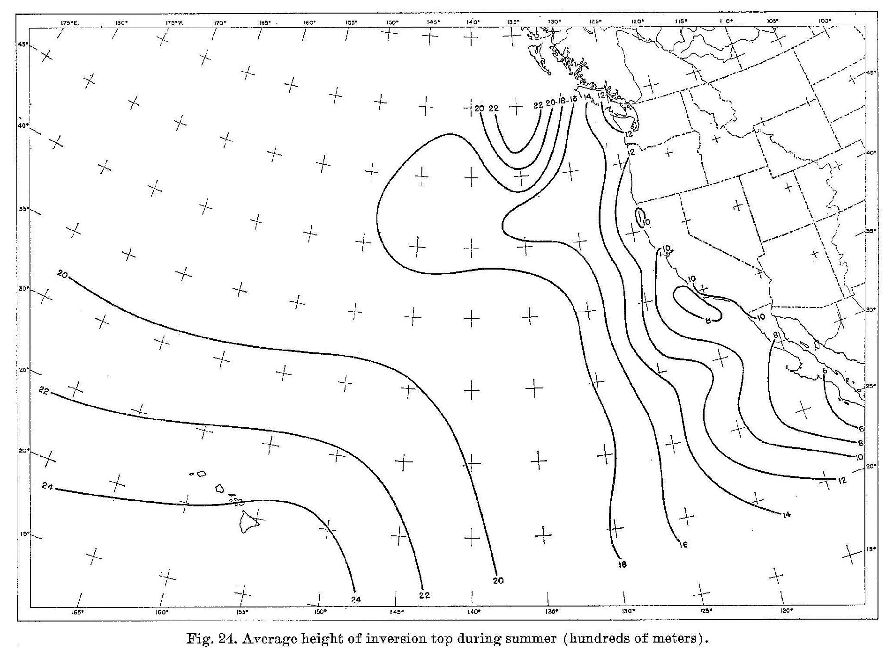
Height of Inversion Top
(Figure obtained from Neiburger et al. (1961), © 1961 Univ. of California Press.)

Slide 9
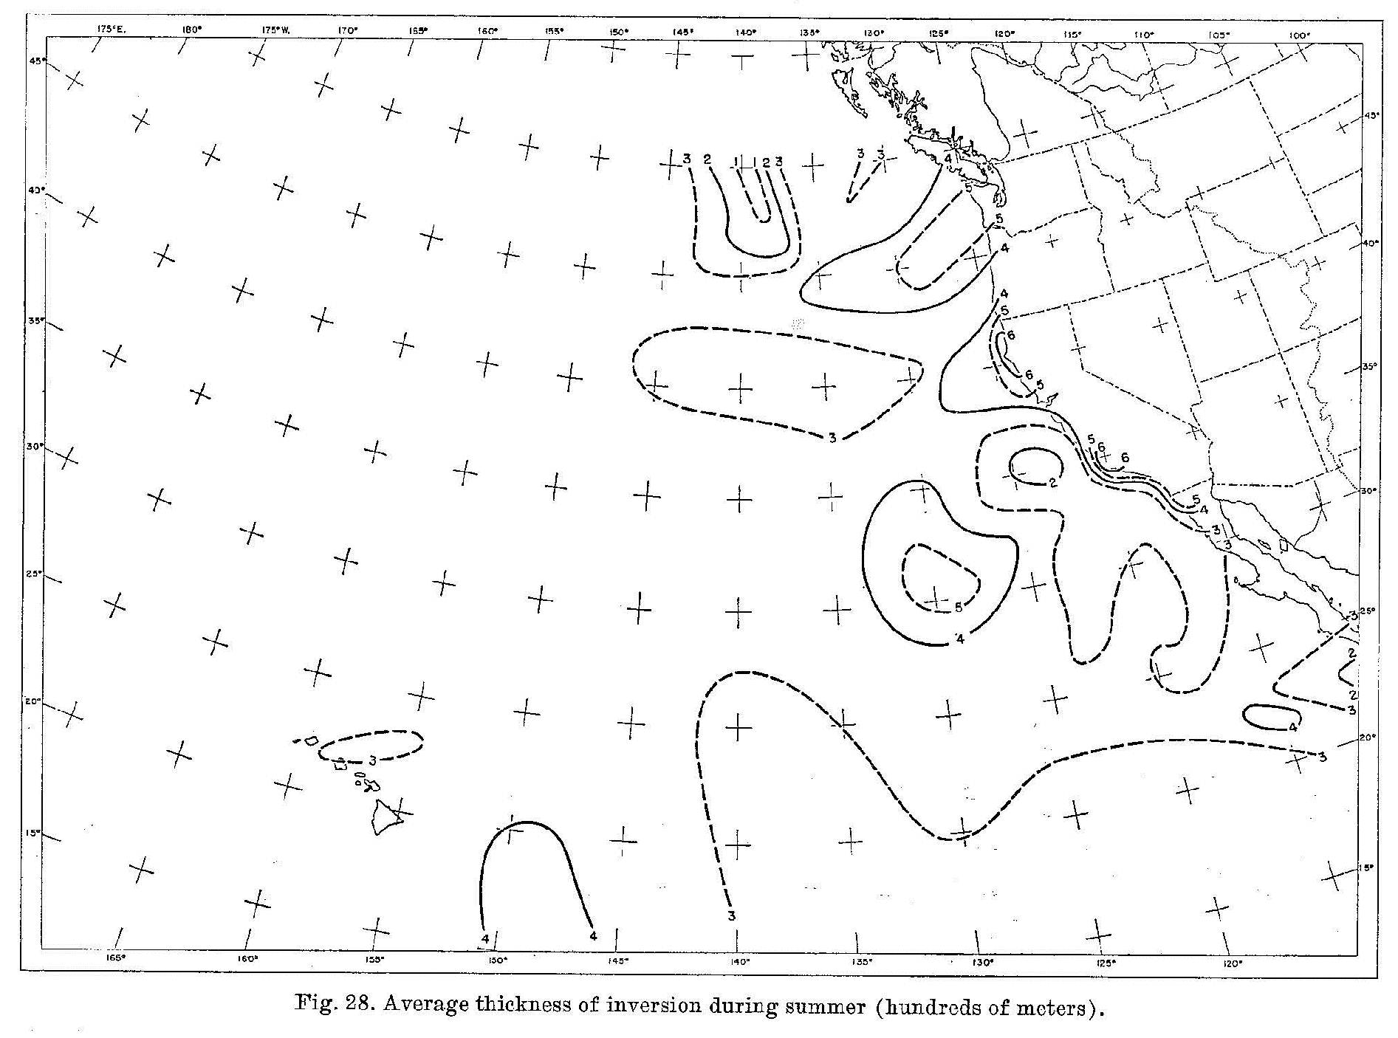
Inversion Thickness
(Figure obtained from Neiburger et al. (1961), © 1961 Univ. of California Press.)

Slide 10
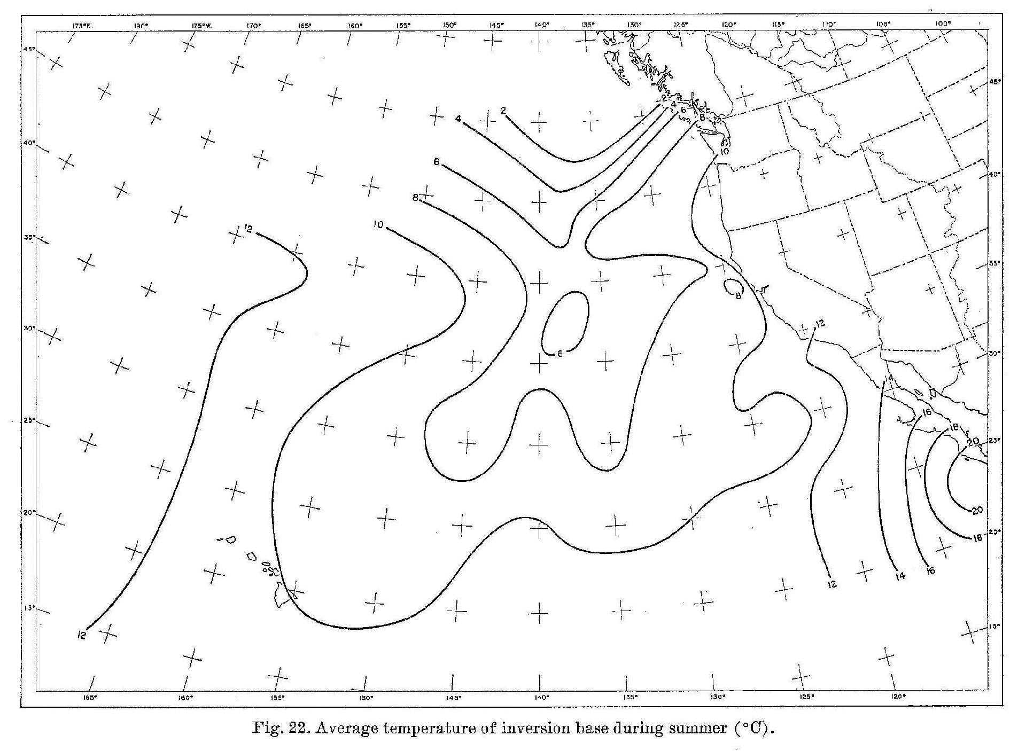
Temperature at Inversion Base
(Figure obtained from Neiburger et al. (1961), © 1961 Univ. of California Press.)

Slide 11
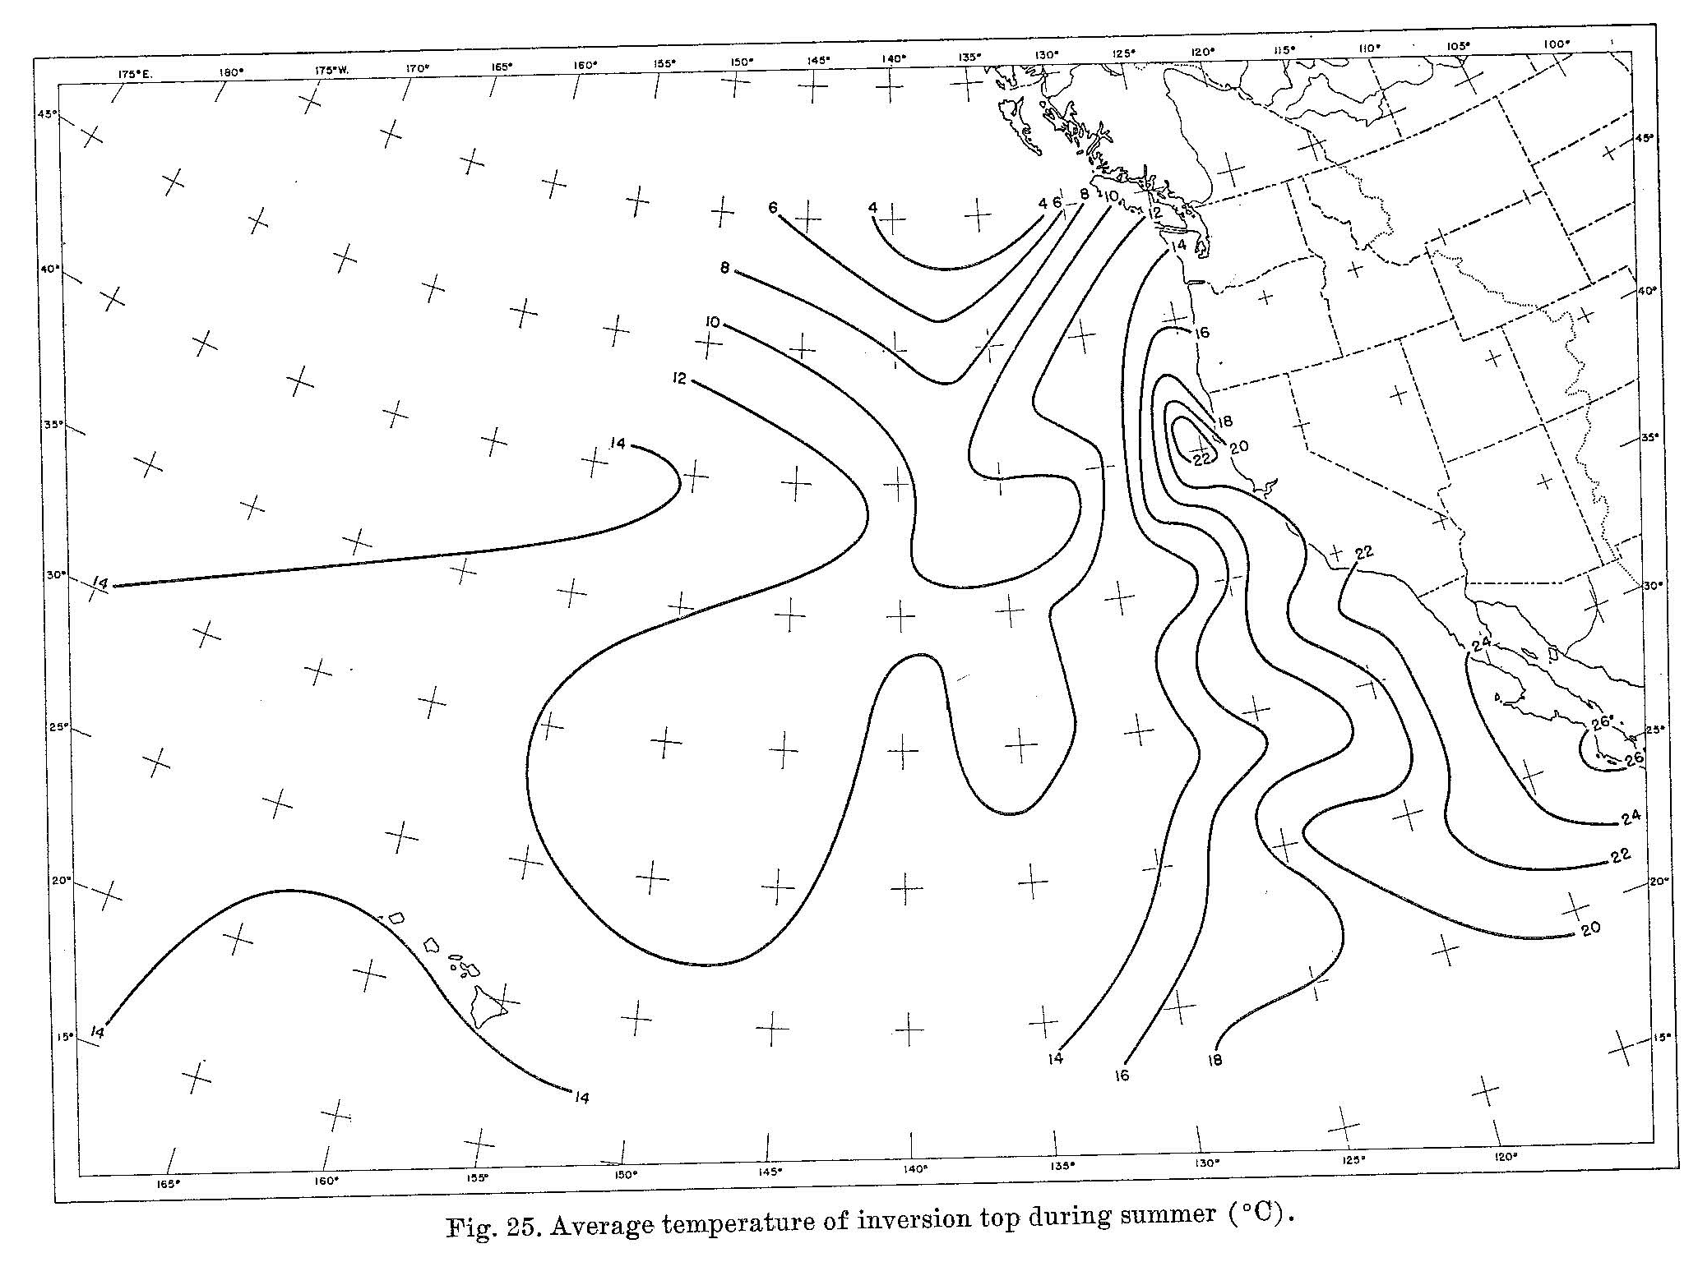
Temperature at Inversion Top
(Figure obtained from Neiburger et al. (1961), © 1961 Univ. of California Press.)

Slide 12
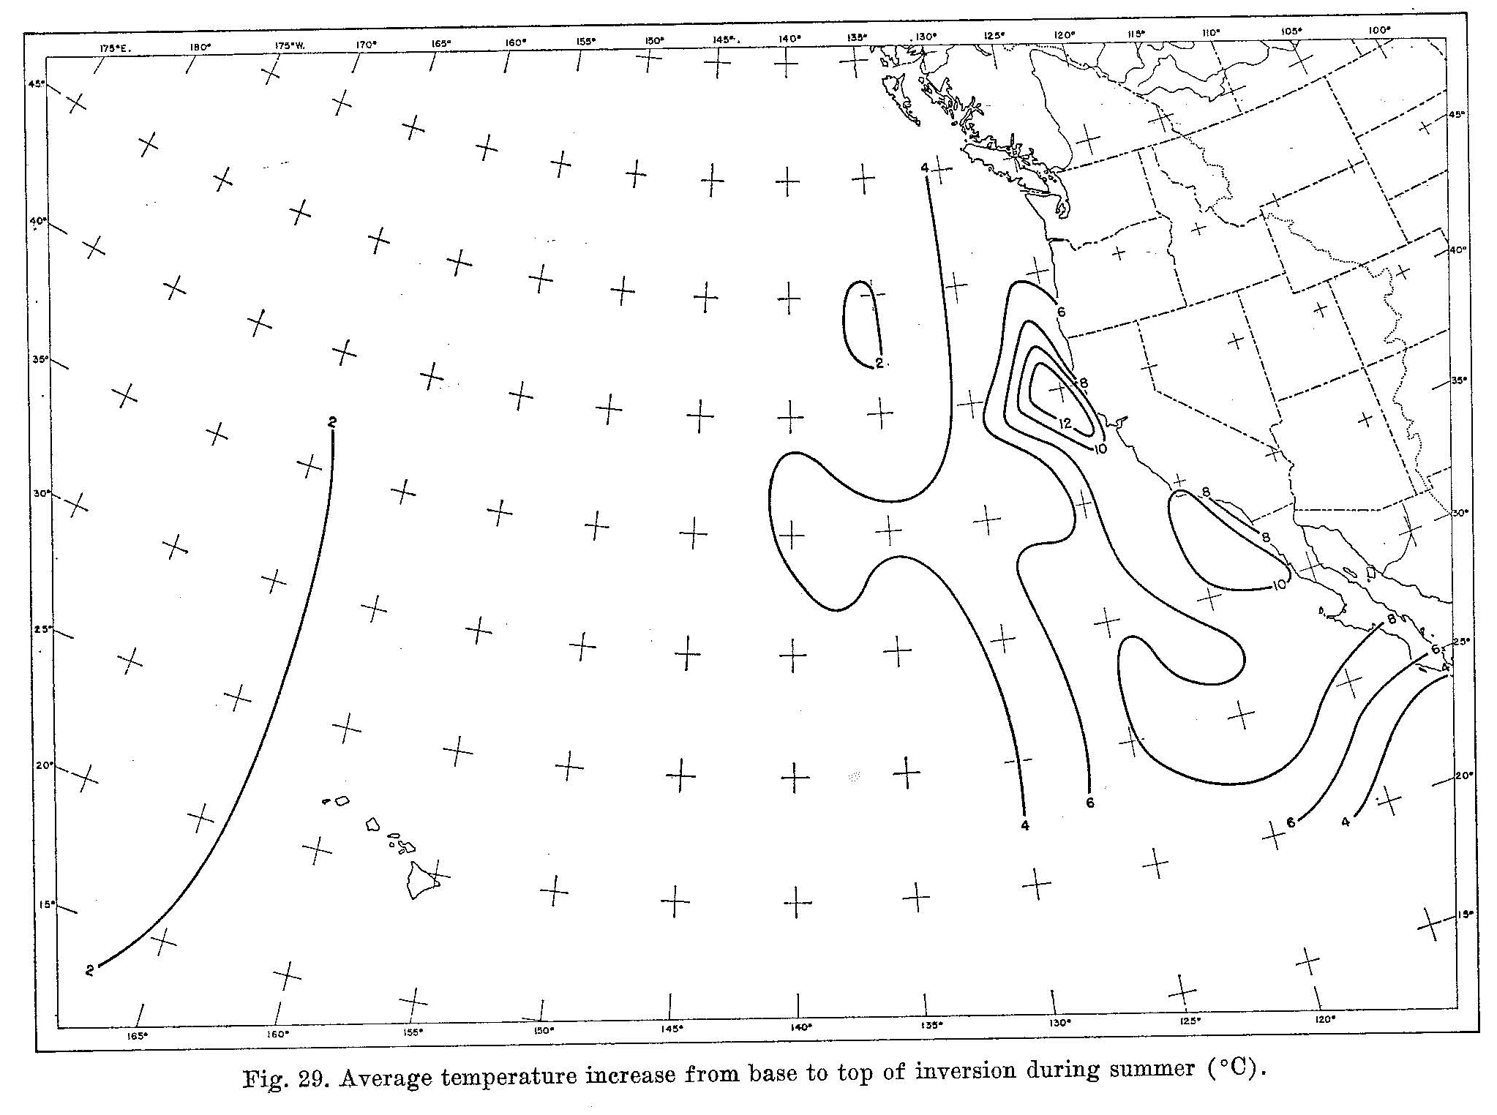
∆T Across Inversion
(Figure obtained from Neiburger et al. (1961), © 1961 Univ. of California Press.)

Slide 13
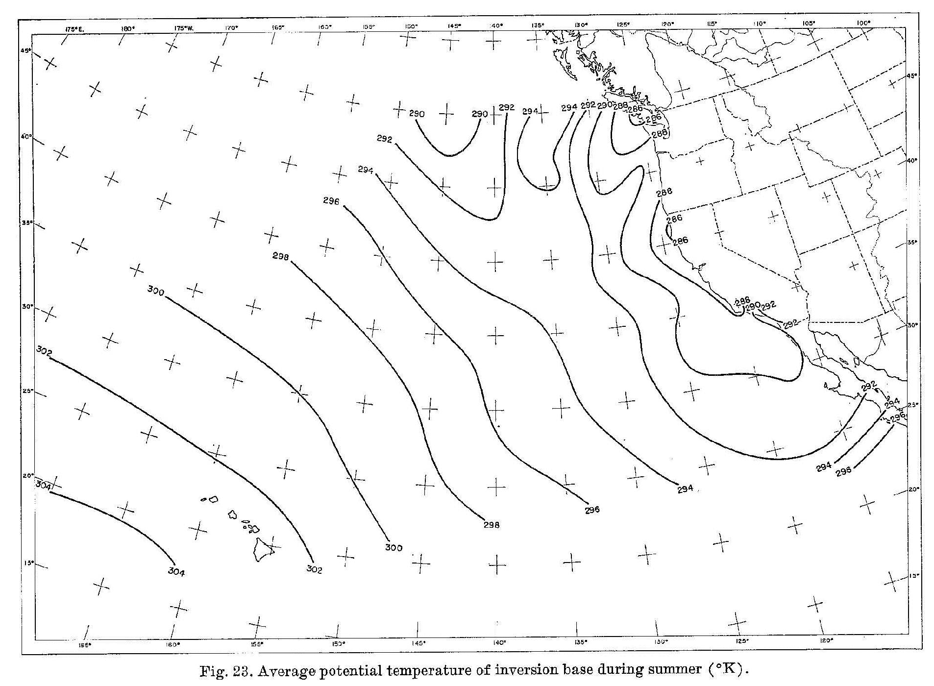
Potential Temperature at Inversion Base
(Figure obtained from Neiburger et al. (1961), © 1961 Univ. of California Press.)

Slide 14
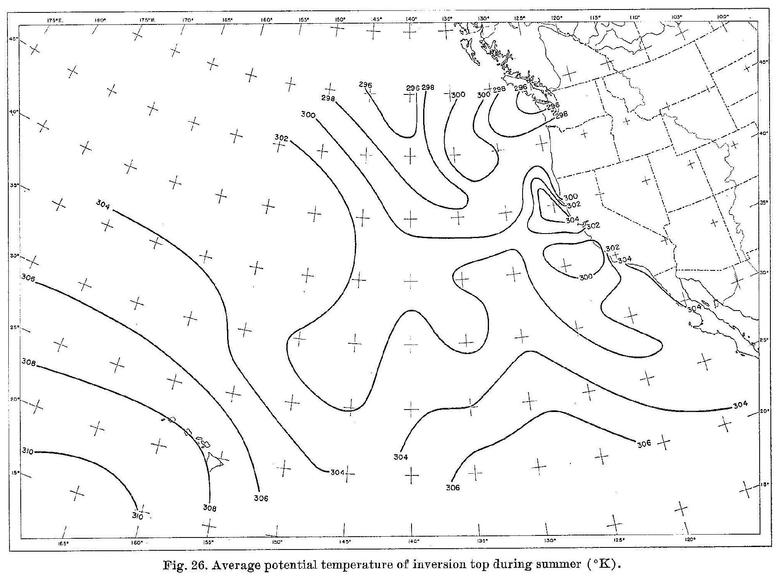
Potential Temperature at Inversion Top
(Figure obtained from Neiburger et al. (1961), © 1961 Univ. of California Press.)

Slide 15
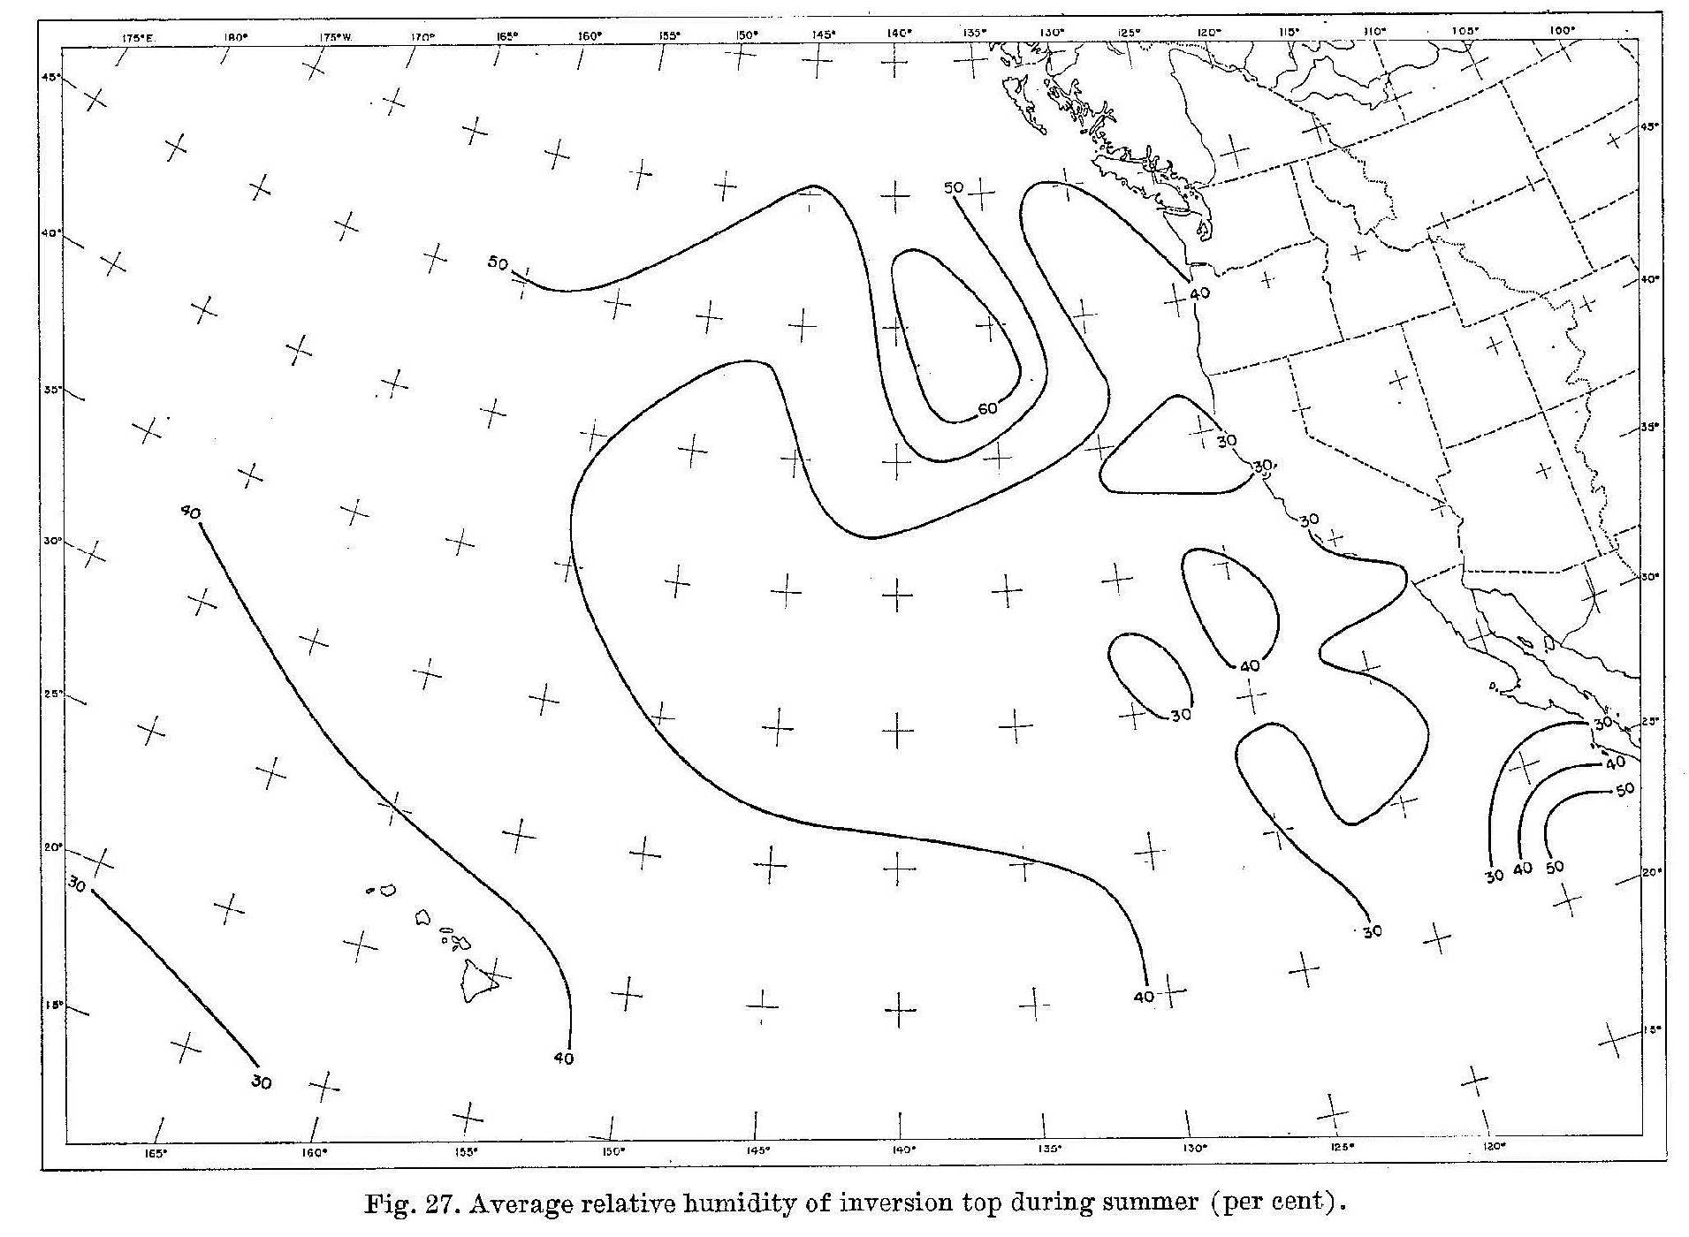
Relative Humidity at Inversion Top
(Figure obtained from Neiburger et al. (1961), © 1961 Univ. of California Press.)

Slide 16
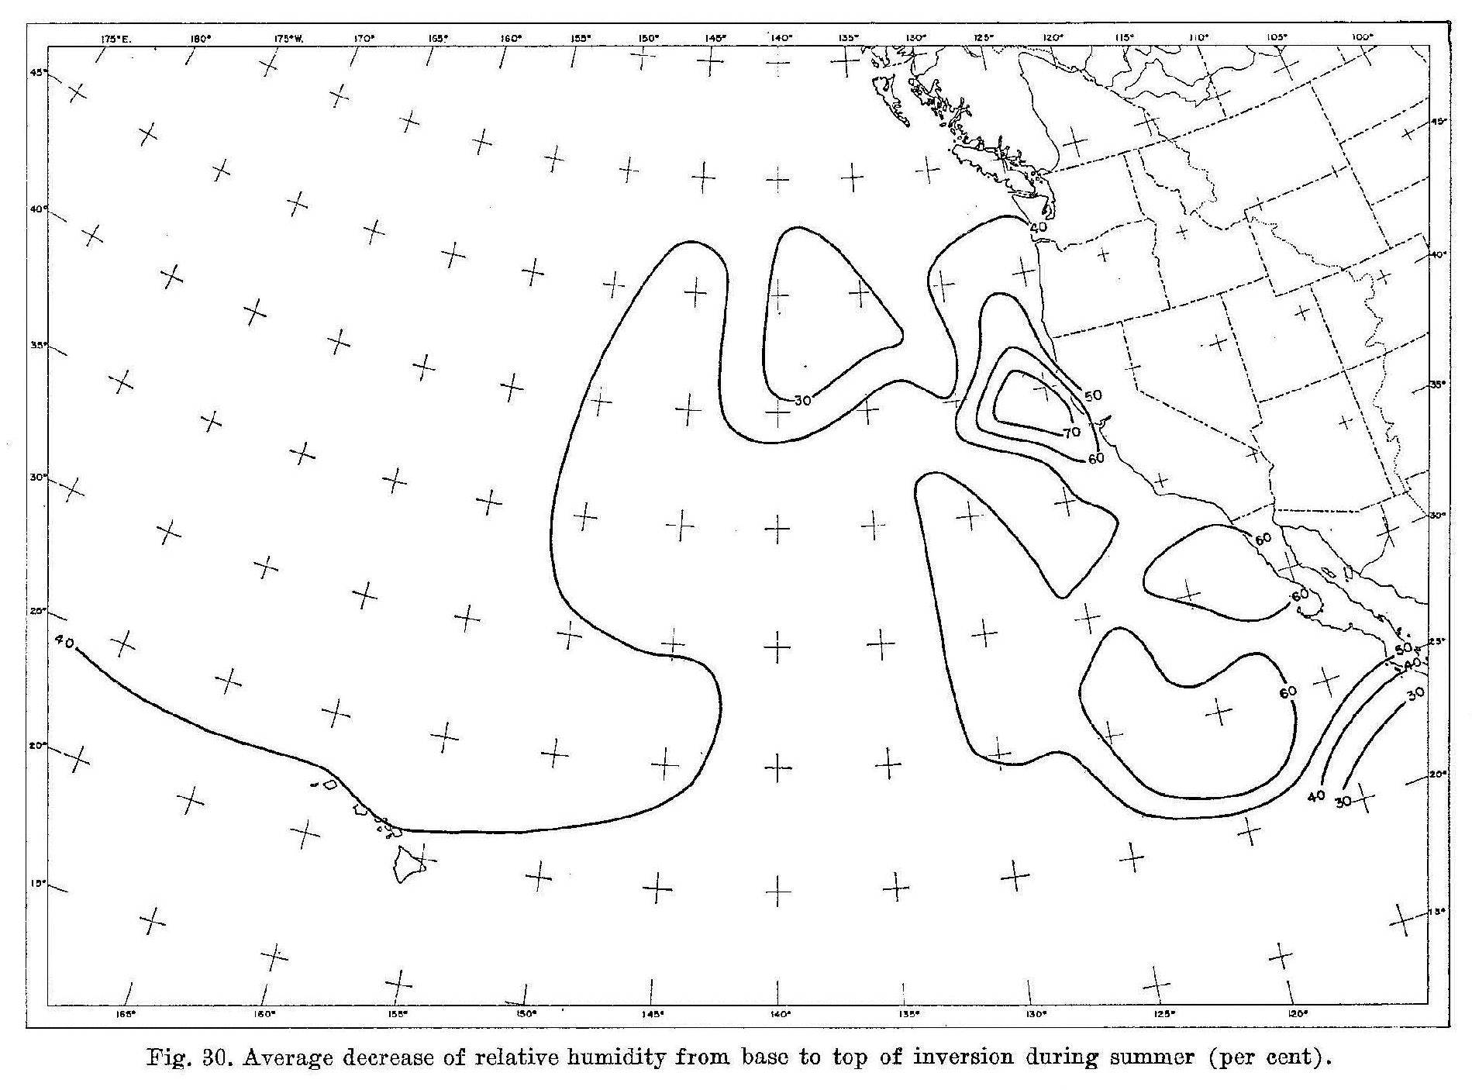
Decrease in RH Across Inversion
(Figure obtained from Neiburger et al. (1961), © 1961 Univ. of California Press.)

Slide 17
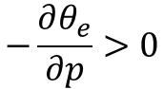
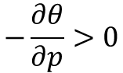
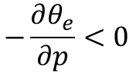
Vertical Structure of ϴ and ϴ_{e}
p
p
inversion layer
inversion layer
ϴ
$$−\frac{∂θ_{e}}{∂p}>0$$
ϴ_{e}
$$−\frac{∂θ}{∂p}>0$$
above inversion
$$−\frac{∂θ_{e}}{∂p}<0$$
below inversion

